Slide 1
CubeSat Networks Balancing Energy Consumption with Data Throughput Stephen Ennis Supervisor: Dr. Jonathon Dukes
Notes:
Working title
35-40m incl. demonstration

Slide 2
Introduction
1 - 2 - 3 - 4 - 5
1
Notes:
<5m

Slide 3
Layout
1 - 2 - 3 - 4 - 5
Introduction: Context, motivations, scope
Prior Art: WSNs, MANETs, Inter-satellite communication
Current Design: Protocol design, simulation demo
Interim Results: Key metrics, discussion
Further Work: Objectives, contributions

Slide 4
Context
CubeSats: Pseudo-standard platform
85% Sensing
Multi-CubeSat missions
Early inter-CubeSat comms missions
1 - 2 - 3 - 4 - 5
Notes:
Multi-CS missions: 3 major last year, 9 major proposed (QB50)

Slide 5
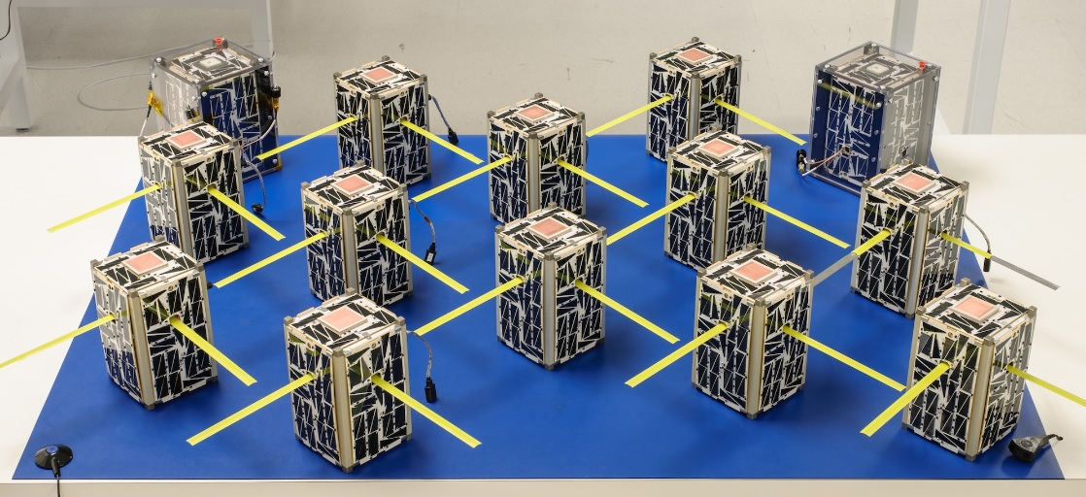
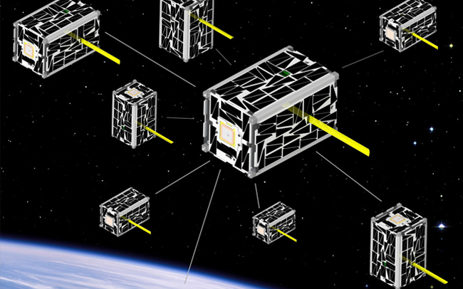
Missions of Note
NASA: EDSN - Nodes [1,2]
CNSA: Tianwang-1 [3]
ESA: GomX-3/4 [4]
QB50 [5]
1 - 2 - 3 - 4 - 5
Notes:
All 2016
1: (NASA) EDSN, Custom Cap/Lt protocol schedule negotiation and Cap election
2: (CNSA TW-1) Gamalink
3: (ESA) Sophisticated model-based prediction/heuristics alogrithm for schedule creation, A-Sync proposed, Mention the balance of power and data budgets
4: Gamalink (Not yet flown)

Slide 6
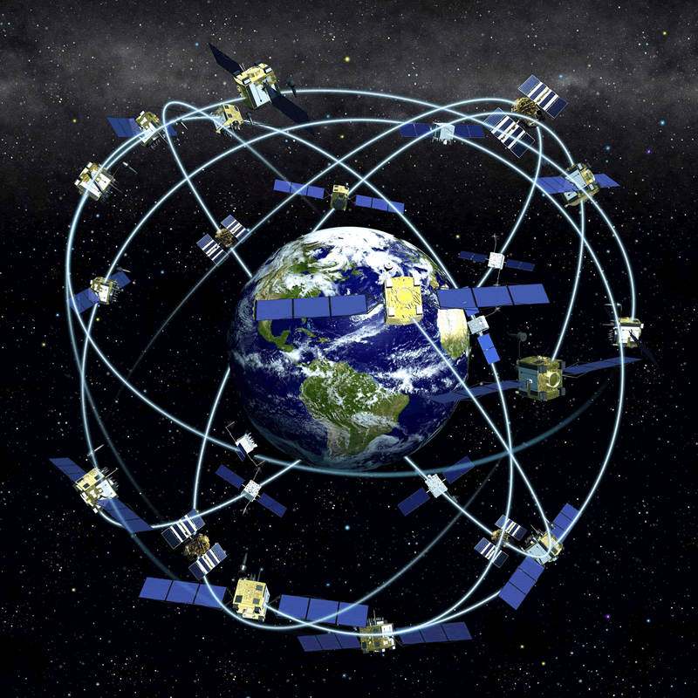
Motivation
1 - 2 - 3 - 4 - 5
Enabling collaborative applications
Limited related work
Untested constellation concepts
High level distributed applications
Low-fidelity simulation or rudimentary analysis
Simulations of CubeSat networks
Notes:
Collaborative applications: Sensing, Communications, Exploration etc.
Untested constellation concepts: Some upcoming missions, some proposals, some very basic investiagtions
High level distributed applications : Challa/McNair
Low-fidelity simulation/analysis of proposed protocols: Radhakrishnan etc. Survey
Refer back to initial motivation: Mission data, CubeSat technology SoA and prior art

Slide 7
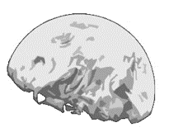
Scope
1 - 2 - 3 - 4 - 5
Data collection problem
Data intensive sensing mission
MAC and routing protocols
Energy vs. throughput
S2G comms with high cost and limited bandwidth
Notes:
Optimization challenge, minimal prior work on developing energy awareness in such scenarios (‘Nodes’ election)
S2G: 500-600km (12kbps) 4W
S2S: Intending to avoid redundant comms but still maintain a somewhat stable mobile network and maximize S2G throughput

Slide 8
Prior Art
1 - 2 - 3 - 4 - 5
2
Notes:
The really fun part of the presentation
Just an overview intended to illustrate the nature of the works considererd
A quick comment on key works

Slide 9
Wireless Sensor Networks
Relevancy
Energy efficiency in wireless sensor networks: A top-down survey - Computer Networks - 2014 [6]
Data collection in wireless sensor networks with mobile elements: A survey - ACM Transactions on Sensor Networks (TOSN) - 2011 [7]
Efficient data collection in wireless sensor networks with path-constrained mobile sinks - IEEE Transactions on Mobile Computing - 2011 [8]
1 - 2 - 3 - 4 - 5
Notes:
1: Energy as a routing metric. Cluster architectures. Cycling. TDMA for Data-gathering application. Cross-layer recommendation
2: WSN-ME architectures, mobile DC/R. Routing (well covered), Discovery, Data Transfer need more
2: Considering same tradeoff, mobile sinks, Maximum Amount Shortest Path (MASP), OMNeT, beats shortest-path-tree
Also: Prediction or not? An energy-efficient framework for clustering-based data collection in wireless sensor networks

Slide 10
Mobile Ad-Hoc Networks
Relevancy
Comparative review study of reactive and proactive routing protocols in MANETs - IEEE International Conference on Digital Ecosystems and Technologies - 2010 [9]
VANET Architectures and Protocol Stacks: A Survey - International Workshop on Communication Technologies for Vehicles - 2011 [10]
Flying Ad-Hoc Networks (FANETs): A Survey - Ad Hoc Networks - 2013 [11]
1 - 2 - 3 - 4 - 5
Notes:
1: Packet loss, delay, jitter, bandwidth, (DREAM) protocol (Pr), DSR praised, CBRP might be next best, stick with reactive. Would like more depth.
2: V2V/V2I, focus MAC/Net+, Mobile IPv6 / 802.11 stack based, far less resource constrained, C2C CC
3: Cross-layer architecture (IMAC-UAV . DOLSR) Cooperative Autonomous Reconfigurable UAV Swarm (CARUS),predictable movement
* Cross layer design for mobile Ad-Hoc Unmanned Aerial Vehicle communication networks (From 3) E2E++ Directional antennae

Slide 11
CubeSat Communications
Relevancy
Inter-satellite links for CubeSats - IEEE Aerospace Conference - 2013 [12]
Survey of Inter-satellite Communication for Small Satellite Systems: Physical Layer to Network Layer View - IEEE Communications Surveys & Tutorials - 2016 [13]
Optimal multiple access protocol for inter-satellite communication in small satellite systems - 4S Small Satellite Systems and Services Symposium - 2014 [14]
1 - 2 - 3 - 4 - 5
Notes:
1: Most focus on physical aspects, based on OLFAR. CDMA/OQPSK proposed.
2: Cross-layer optimization and adaptivitiy emphasized. LDMA, handover and route discovery. Source for chosen prior art.
3: Mirroring parameters. TDMA centric etc. TP/Access/E2E, DS-CDMA, fixed slot assignment etc. extend future work. 95% TP.
"The current state of the art for small satellite communications is a one hop link between satellite and ground stations"
OLFAR: orbiting low frequency array (swarm concept)

Slide 12
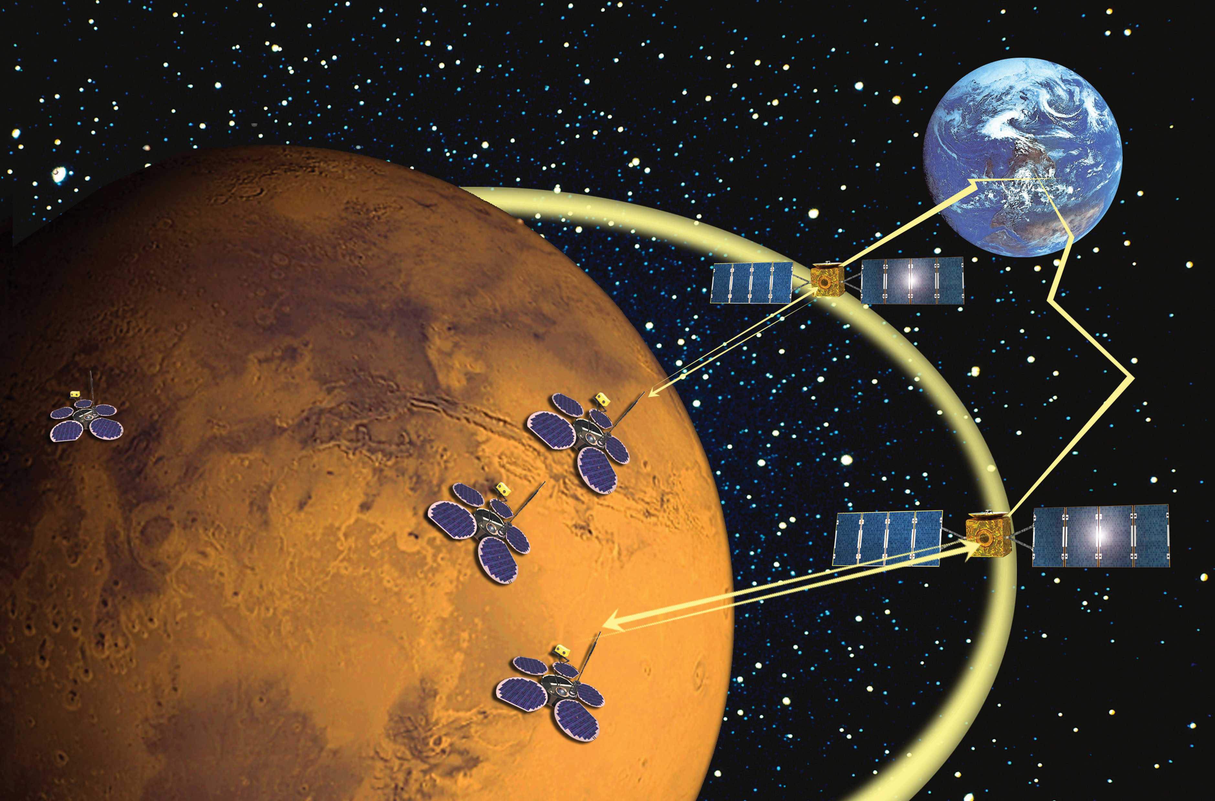
Other Areas of Note
Delay Tolerant Networking
AODV and friends
RPL
GNSS Clock Synchronization
1 - 2 - 3 - 4 - 5
Notes:
1: Delay-and disruption-tolerant networking (DTN): an alternative solution for future satellite networking applications (Farrell)
2: Performance comparison of AODV, DSDV, OLSR and DSR routing protocols in mobile ad hoc networks (Many such papers exist)
3: RPL in a nutshell: A survey (A rather large nutshell)
4: Synchronization and syntonization of formation flying cubesats using the namuru V3. 2 spaceborne GPS receiver

Slide 13
Current Design
1 - 2 - 3 - 4 - 5
3
Notes:
10m (5m CubeMac / 5m Demo)

Slide 14
Quick Timeline
1 - 2 - 3 - 4 - 5
Began work with Dr. Farrell – Week 1M
Change of supervisor to Dr. Dukes – 8M
Reassessment/Scoping – 8M : 11M
Dropped dynamics modeling & began work with NS-3 – 12M
Switched to OMNeT++ - 2H
Modelling prior art MAC protocol – 3H : 8H
Introducing ground station – 8H : Present

Slide 15
CubeMac
Cluster based hybrid TDMA/CDMA scheme
Cluster consists of one Master (M) and n Slaves (S)
Masters use TDMA
Slaves use CDMA within dedicated “uplink” slot
Fixed time slots, slot assignment and cluster configurations
1 - 2 - 3 - 4 - 5
Notes:
Besides high-level work on the project the bulk of the work thus far has gone into replicating the prior work of Radhakrishnan et al.
Authors speak of reclustering/master election but give no details on the approach taken
Hopefully moving away from fixed approach

Slide 16
CubeMac
1
2
S
S
M
M
S
S
CDMA
1
2
s
1 - 2 - 3 - 4 - 5

Slide 17

Swarms
500-700km
Notes:
Spacings of 10-100km

Slide 18
Demonstration
1 - 2 - 3 - 4 - 5

Slide 19
Interim Results
1 - 2 - 3 - 4 - 5
4
Notes:
5m

Slide 20
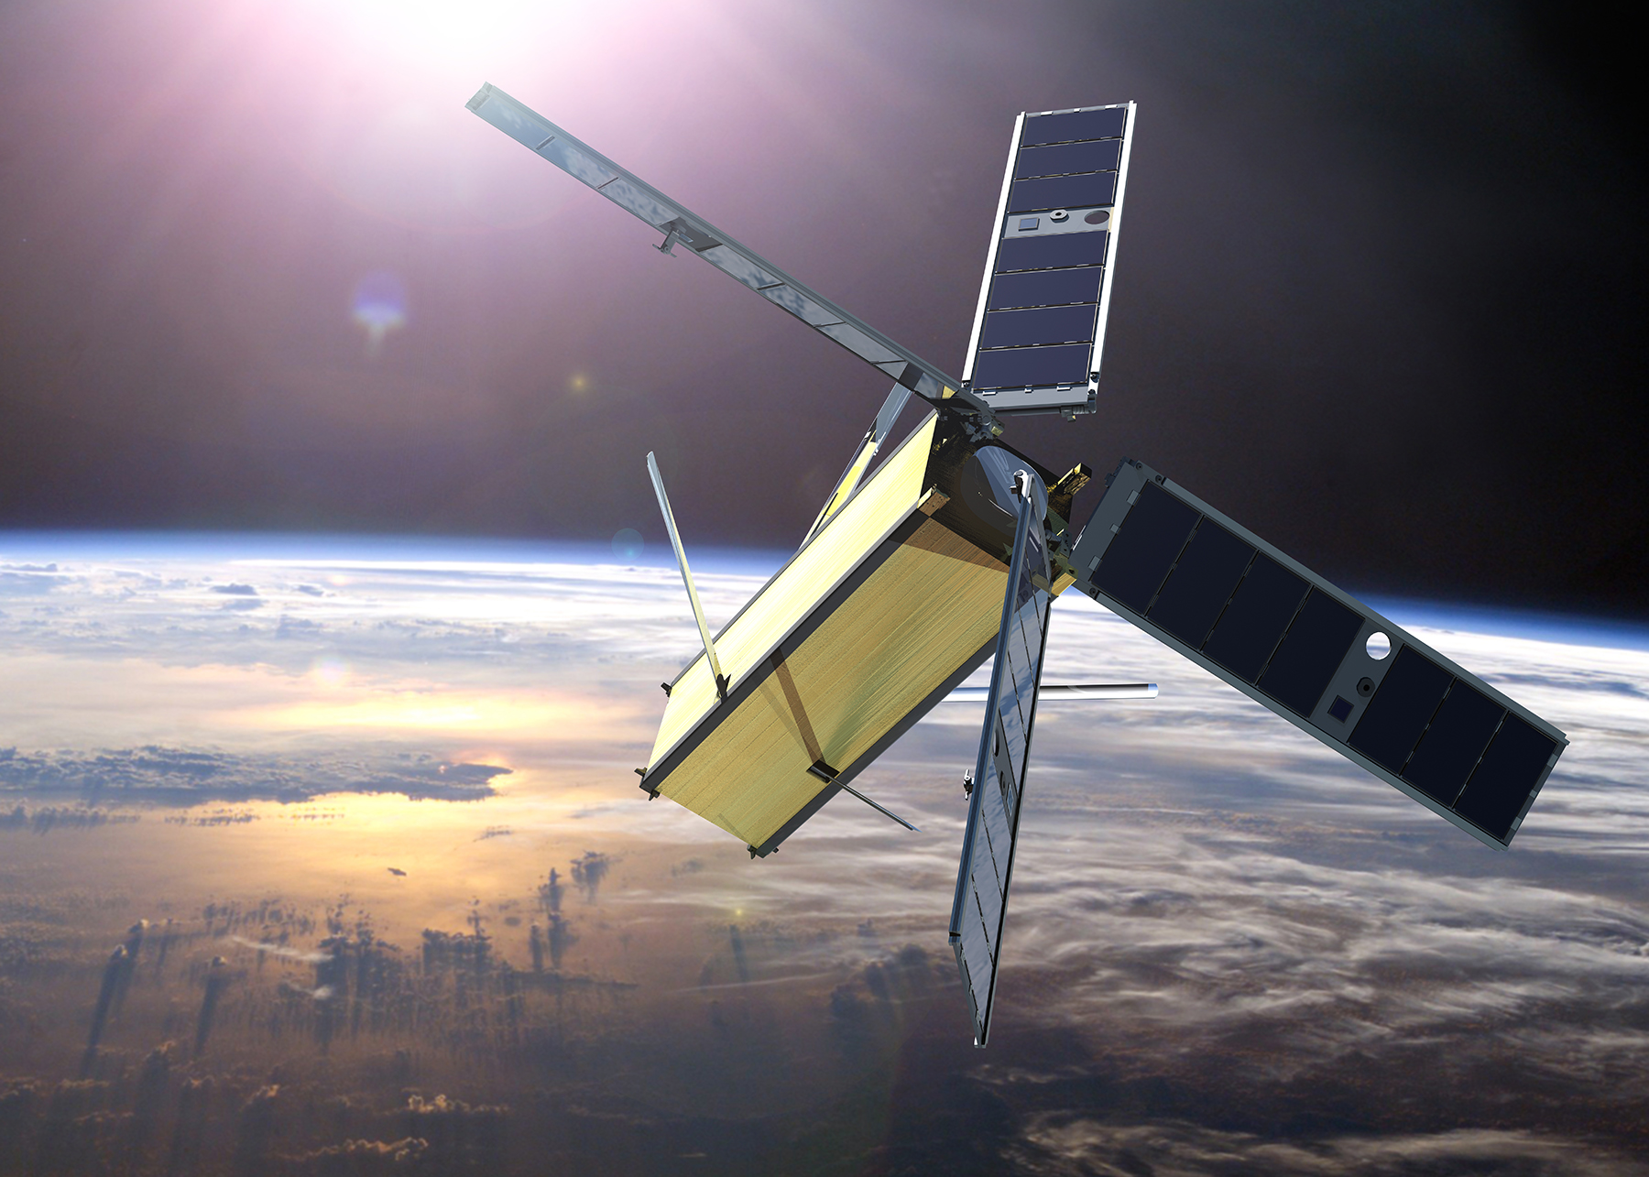
Key Metrics
S2G Throughtput
End-to-end delay
MAC access delay
Energy consumption
Scenario: 100s, 100ms slots, Sweeping packet size / interval
1 - 2 - 3 - 4 - 5
Notes:
1: Given
2: Ramifications for limited mission schedules and reliability
3: The amount of time packets spend waiting on MAC queue
4: State based

Slide 21
1 - 2 - 3 - 4 - 5
Notes:
Stacked 1s 64B == 0.5s 32B – 0.5 256B == 0.25 128B
As packet size increases less packets sent per slot (overall slot utiliziation will decrease)
256 approaches the largests packet size that a slot of 100ms can handle can handle
-- Error bars
-- Confidence intervals

Slide 22
1 - 2 - 3 - 4 - 5
Notes:
Across all runs
Packets reaching ground in under approx 1.5 frames as expected (Each frame = 0.6s)

Slide 23
1 - 2 - 3 - 4 - 5
Notes:
Across all runs

Slide 24

1 - 2 - 3 - 4 - 5
Notes:
Over 100s period

Slide 25
1 - 2 - 3 - 4 - 5
Notes:
Zero recharge
-- Analysis statistical significance in (CI/R^2) in dissertation

Slide 26
Ongoing & Further Work
1 - 2 - 3 - 4 - 5
5
Notes:
<5m

Slide 27
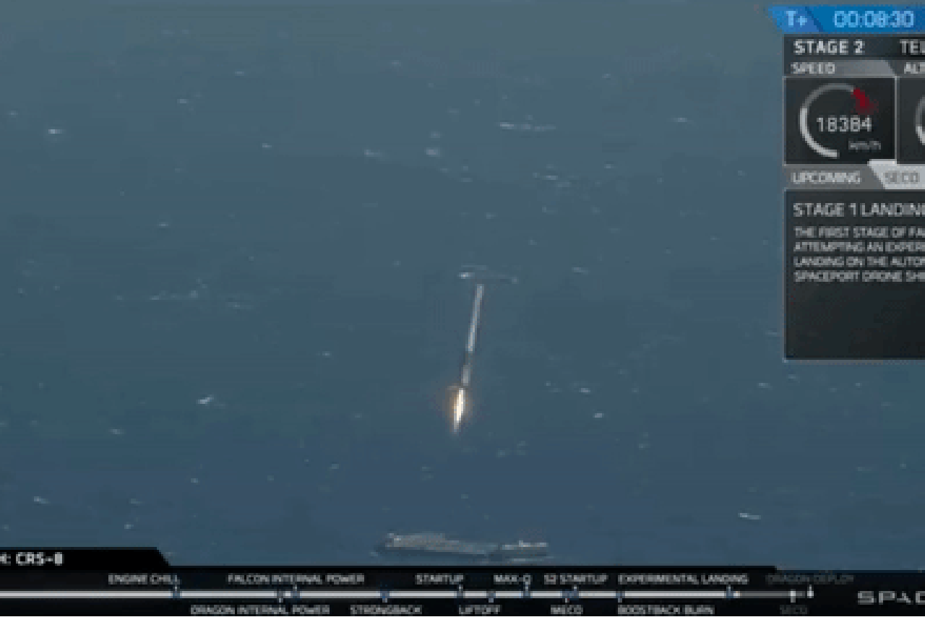
Objectives
Ground station
CubeMac
Routing
Energy Awareness
Stick the landing
Improvements
Novel Contributions
1 - 2 - 3 - 4 - 5

Slide 28
Expected Contributions
Analysis of hybrid TDMA/CDMA, Routing schemes
Mission critical throughput vs. energy factor
Open-source simulation for LEO SmallSat communications
Opportunities to model sophisticated energy schemes and applications
Design that reflects both missions and research
Assessment and synthesis of varied prior art
1 - 2 - 3 - 4 - 5

Slide 29
Thank You

Slide 30
Questions
?

Slide 31
References
[1] J. Hanson, A. G. Luna, R. DeRosee, K. Oyadomari, J. Wolfe, W. Attai, et al., "Nodes: A Flight Demonstration of Networked Spacecraft Command and Control," 2016.
[2] D. Westley, A. Martinez, and A. Petro, "Edison Demonstration of Smallsat Networks," 2015.
[3] S. Wu, W. Chen, and C. Chao, "The STU-2 CubeSat Mission and In-Orbit Test Results," 2016.
[4] M. Bisgaard, D. Gerhardt, H. Hermanns, J. Krčál, G. Nies, and M. Stenger, "Battery-Aware Scheduling in Low Orbit: The GomX–3 Case," in FM 2016: Formal Methods: 21st International Symposium, Limassol, Cyprus, November 9-11, 2016, Proceedings 21, 2016, pp. 559-576.
[5] D. Masutti, T. Banyai, J. Thoemel, T. Magin, B. Taylor, and D. Kataria, "Investigating the Middle and Lower Thermosphere using a Cubesat Constellation: the QB50 Mission and its Particular Challenges," in EGU General Assembly Conference Abstracts, 2015, p. 9016
[6] T. Rault, A. Bouabdallah, and Y. Challal, "Energy efficiency in wireless sensor networks: A top-down survey," Computer Networks, vol. 67, pp. 104-122, 2014.
[7] M. Di Francesco, S. K. Das, and G. Anastasi, "Data collection in wireless sensor networks with mobile elements: A survey," ACM Transactions on Sensor Networks (TOSN), vol. 8, p. 7, 2011.
[8] S. Gao, H. Zhang, and S. K. Das, "Efficient data collection in wireless sensor networks with path-constrained mobile sinks," IEEE Transactions on Mobile Computing, vol. 10, pp. 592-608, 2011.
[9] S. Mohseni, R. Hassan, A. Patel, and R. Razali, "Comparative review study of reactive and proactive routing protocols in MANETs," in Digital ecosystems and technologies (DEST), 2010 4th IEEE international conference on, 2010, pp. 304-309.
[10] S. A. Mohammad, A. Rasheed, and A. Qayyum, "VANET architectures and protocol stacks: a survey," in International Workshop on Communication Technologies for Vehicles, 2011, pp. 95-105.
[11] I. Bekmezci, O. K. Sahingoz, and Ş. Temel, "Flying ad-hoc networks (FANETs): A survey," Ad Hoc Networks, vol. 11, pp. 1254-1270, 2013.
[12] A. Budianu, T. J. W. Castro, A. Meijerink, and M. J. Bentum, "Inter-satellite links for cubesats," in Aerospace Conference, 2013 IEEE, 2013, pp. 1-10.
[13] R. Radhakrishnan, W. W. Edmonson, F. Afghah, R. M. Rodriguez-Osorio, F. Pinto, and S. C. Burleigh, "Survey of Inter-satellite Communication for Small Satellite Systems: Physical Layer to Network Layer View," IEEE Communications Surveys & Tutorials, vol. 18, pp. 2442-2473, 2016.
[14] R. Radhakrishnan, W. W. Edmonson, F. Afghah, J. Chenou, R. M. Rodriguez-Osorio, and Q.-A. Zeng, "Optimal multiple access protocol for inter-satellite communication in small satellite systems," in 4S Small Satellite Systems and Services Symposium, 2014.

